Slide 1
Why Delaware?
Delaware’s Continuing Role as the Nation’s Corporate Law Leader
Presented by Francis G.X Pileggi, Sean M. Brennecke & Chauna Abner

Slide 2
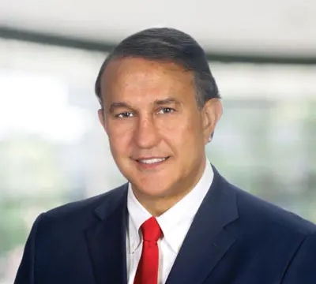

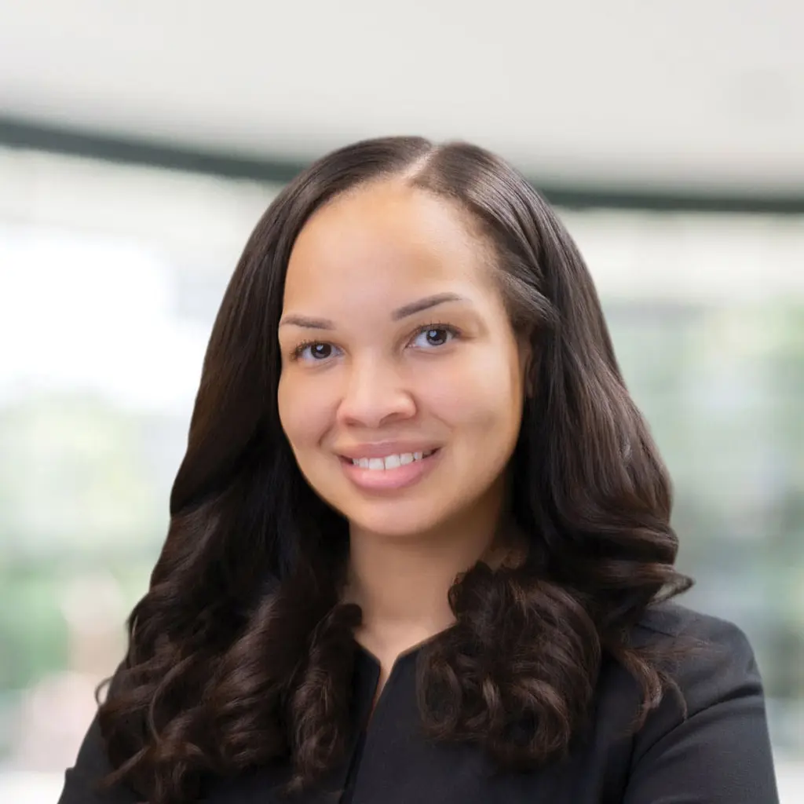

Presenters
Francis G.X Pileggi
Sean M. Brennecke
Chauna A. Abner

Slide 3
Directors & Officers Litigation Practice Group
Lewis Brisbois’ Directors & Officers Litigation Practice Group represents directors and officers, as well as managers in alternative entities and investors in closely-held and publicly-traded corporations—from small to mid-sized entities, to Fortune 500 companies. Our team consists of seasoned litigators who have handled the gamut of cases: individual, derivative, and class actions in federal and state courts, “bet-the-board” and “bet-the-company” litigation, breach of fiduciary duty claims, business divorces, partnership disputes, requests for injunctive relief, as well as securities law violations.

Slide 4
Statistics

Slide 5
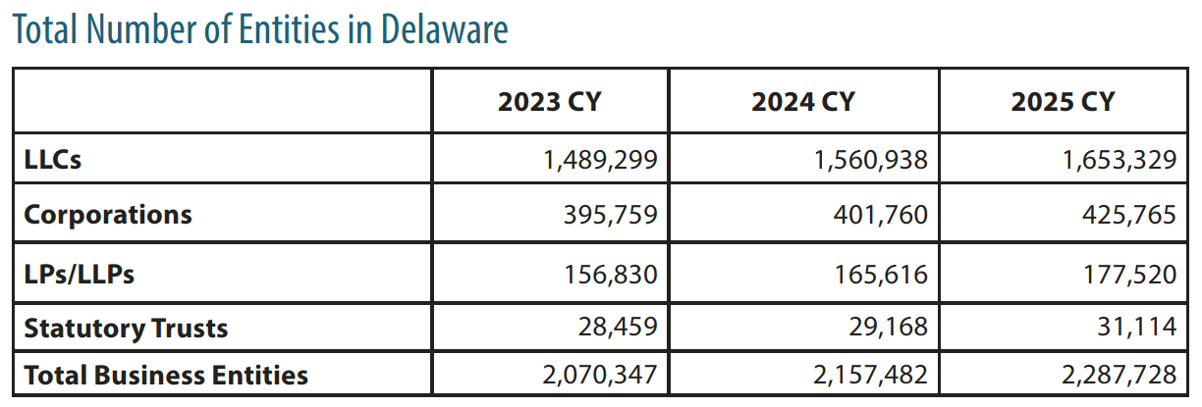
Number of Corporations & Alternative Entities¹
As of the last calendar year, 2.28 million entities (over two-thirds of the Fortune 500) are incorporated in Delaware.
¹Delaware Division of Corporations: 2025 Annual Report

Slide 6
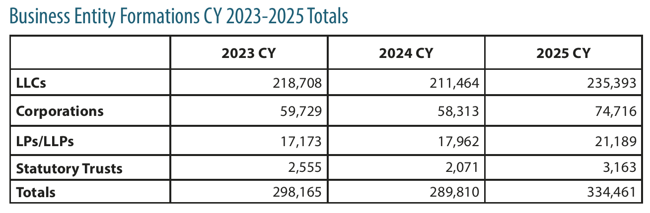
Growth of Incorporation & Creation of New Alternative Entities Over Past 3 Years¹
For the 2025 year - 334,461 new entities were formed in Delaware.
  > 15% increase over 2024
¹ Delaware Division of Corporations: 2025 Annual Report

Slide 7
Reasons for Incorporating in Delaware

Slide 8
Court Systems & Jurisdiction
Supreme Court
  Court of last resort – civil, criminal and miscellaneous appeals. No intermediate appellate court.
2025 Supreme Court Statistics²
  557 new filings
    300 civil appeals
  522 dispositions
    273 civil dispositions
Expedited appeals routinely allowed
Internal guidelines provide for decisions within 90 days
    ²Delaware Supreme Court 2025 Annual Report Delaware Judiciary 2025 Annual Statistical Report

Slide 9
Court Systems & Jurisdiction
Chancery Court³
  Preeminent business court in country
  2025 Chancery Court Statistics
    1,404 new civil cases filed
    1,466 civil cases resolved
  Cases are often expedited
  Internal guidelines provide for decisions within 90 days
  ³ Supreme Court 2025 Annual Report Delaware Judiciary 2025 Annual Statistical Report

Slide 10
Court Systems & Jurisdiction
Superior Court – Complex Commercial Litigation Division (CCLD)⁴
  Special division of court of general jurisdiction
  $1 million minimum amount in controversy
  Voluntary – one or all parties must elect to have matter heard in CCLD
  Rules and procedures are more flexible - similar to Court of Chancery
  ⁴ Supreme Court 2025 Annual Report Delaware Judiciary 2025 Annual Statistical Report

Slide 11
Favorable, Established & Predictable Corporate Laws
“Delaware’s General Corporation Law is widely regarded as the most advanced, modern and flexible corporate statute in the nation. Similarly, Delaware’s statutes governing limited liability companies, limited partnerships, and statutory trusts offer substantial contractual flexibility to design and implement governance structures to accommodate the parties’ business goals and objectives.”⁵
⁵Delaware Division of Corporations 2025 Annual Report - Delaware Division of Corporations: 2025 Annual Report

Slide 12
Division of Corporations
Corporate filings
  Expedited one-hour service available
  Electronic filings
  Filings processed in approximately 30 minutes
See Recent Bloomberg Law Article by Francis G.X. Pileggi and Aimee Czachorowski comparing Delaware and Texas filings

Slide 13
Sophisticated and Responsive Legal Community
Comparatively small bar / frequent players
  2025
    Delaware – 306 people took the bar exam, 204 people passed⁶
    New York – 14,021 people took the exam, 8,559 people passed
High specialized
“The Delaware Way”
⁶ Persons Taking and Passing the 2025 Bar Examination - National Conference of Bar Examiners

Slide 14
Use of Delaware Law

Slide 15
Internal Affairs Doctrine
Only applies to “matters that pertain to the relationships among or between the corporation and its officers, directors, and shareholders”
Does not apply to matters where third-parties rights are involved, e.g. contracts and torts
Examples include shareholder right disputes, and corporate governance issues
Juul Labs, Inc. v. Grove, 238 A.3d 904, 914 (Del. Ch. 2020)

Slide 16
Forum Selection Clauses
See Kelly Roofing Holdings, LLC v. Flores, C.A. No. 2025-1049-BWD (Del. Ch. June 4, 2026) (addressing (i) when language in a forum clause is permissive or mandatory; (ii) which venue prevails when two related agreements provide for different forum requirements; and (iii) when the first-filed McWane rule is trumped by a forum selection clause)
Exclusive v. permissive
Court’s tendency to enforce clear forum selection clauses
Discussion of recent case law on forum selection clauses

Slide 17
Tesla & DExit

Slide 18
Tesla Litigation and Reincoporation to Texas
  February 2024 – Chancellor Kathaleen McCormick ordered recission of a performance-based stock option grant Tesla’s board of directors approved for Elon Musk with a potential $55.8 billion maximum value. Tornetta v Musk.aspx
    April 2025 – Delaware Supreme Court unanimously reversed the Chancery decision and reinstated the grant, stating that rescission would leave Musk uncompensated for six years of service. In re Tesla Deriv. Litig.aspx
  June 2024 – Tesla reincorporated in Texas

Slide 19
DExit and a “Trend” of Reincorporating Away from Delaware
“DExit”
  Phrase commentators used to describe a series of companies reincorporating away from Delaware
  Began with Tesla reincorporation in June 2024
  Commonly based on company’s perception that Delaware courts were activists and restricting corporate rights
But
  No decrease in recent new entities formed in Delaware post-2025 changes by SB 21
  See also
    Delaware Keeps Business Filing Edge as Texas Starts Fast Service
    Delaware Corporate Filing Services Still Superior Despite Texas Improvements

Slide 20
Delaware Legislature Response (SB 21)
Delaware Legislature passed Senate Bill 21 amending two sections of the Delaware General Corporation Law
  New safe harbor for potentially conflicted transactions (8 Del. C. § 144)
  More limited shareholder’s right to books and records (8 Del. C. § 220)
Commentators suggested this was a direct result of the Tesla Litigation and DExit

Slide 21
Delaware Legislature Response (SB 21)
Transaction Safe Harbor (8 Del. C. § 144)
  Amendment clarified that the “safe harbor” for interested transactions involving conflicted directors or officers also applied to a “controlling stockholder” (including a definition of that term), provided that the transaction is approved by either:
    (i) an informed majority of the corporation’s disinterested directors acting in good faith; or
    (ii) an informed majority of the corporation’s disinterested stockholders

Slide 22
Delaware Legislature Response (SB 21)
Books and Records (8 Del. C. § 220) amendment
    Provided companies with more defenses to a Section 220 demand
    Defined and limited the materials a stockholder may demand to inspect (as opposed to then-current “guess work” approach)
    Established the relevant time period for a books and records demand at 3 years prior to demand
    Set out conditions that must be satisfied in connection with a books and records production

Slide 23
Popularity of Texas and Nevada
Texas and Nevada became popular jurisdictions for reincorporation
Texas and Nevada laws and court procedures are decidedly pro-company and are less restrictive of management

Slide 24
Texas and Nevada
Notable differences between Delaware, Texas and Nevada laws regarding corporations⁷
⁷The information in this chart is an excerpt of an affiliate of the Council of Institutional Investor’s, CII Research and Education Fund’s, 2026 Comparison of Key Corporate Governance Features in Select Jurisdictions. 2026 Comparison of Key Corporate Governance Features in Select Jurisdictions.pdf
 | Delaware | Nevada | Texas
Director and Officer Liability | No liability unless the director or officer acted with at least gross negligence | Liability only for intentional misconduct, fraud or knowing violation of the law | Liability only for intentional misconduct, fraud or knowing violation of the law
Books and Records Inspection Rights | Right to inspect specified in amended DGCL § 220 | Generally, no inspection rights for publicly traded Nevada corporations | Right to inspect except for improper purpose or litigation. Excludes emails, text messages, etc… except when needed for action by the company.

Slide 25
Texas and Nevada
 | Delaware | Nevada | Texas
Court deference to Directors | Business judgment rule except for certain cases (conflicted controller transactions or director and officer conflicts) | Business judgment rules applies even to conflicted transactions unless there was intentional misconduct, fraud, or a knowing violation of the law. | Courts defer to directors unless plaintiffs can show was intentional misconduct, fraud, or a knowing violation of the law
Court Consideration of Conflicted Directors | New safe harbor provision – rebuttal presumption that directors are disinterested if they meet stock exchange independence standards | Directors must meet stock exchange standards and not have a material and nonspeculative financial interest in, nor be a party to, the contract or transaction | Directors are presumed to be acting in good faith and no claims may be brought against them unless plaintiffs prove fraud, intentional misconduct, or knowing violation of the law

Slide 26
Texas and Nevada
 | Delaware | Nevada | Texas
Shareholder Litigation Rights | Any shareholder can seek redress of damages individually when the company fails to act in response to a complaint and the court finds the claim reasonable. Derivative actions require a showing that at least half of the board has a conflict or is dependent on someone with a conflict. Exclusive forum selection clauses are permitted | Any shareholder can seek redress of damages individually when the company fails to act in response to a complaint and the court finds the claim reasonable Exclusive forum selection clauses are permitted | Company can limit derivative suit rights to holders of at least 3% of the company’s stock Exclusive forum selection clauses are permitted

Slide 27
Texas and Nevada
 | Delaware | Nevada | Texas
Court System | Specialized Chancery Court and long history of precedent | Two judicial circuits have designated judges as Business Court Judges. Specific Business Court awaiting approval by Nevada legislature and public referendum Estimated that the court will not be operational until 2028 or later | New business court system established in 2024.

Slide 28
Impact of DExit on Growth of Incorporations & Alternative Entity Formation
Some commentary suggests that DExit has led to increase in companies incorporating away from Delaware. See e.g. DExit: Reincorporation Data Seem to Support the Hype
However, empirical evidence confirms that DExit has had no meaningful impact on the number of entities being formed in Delaware.

Slide 29

Questions?

Slide 30
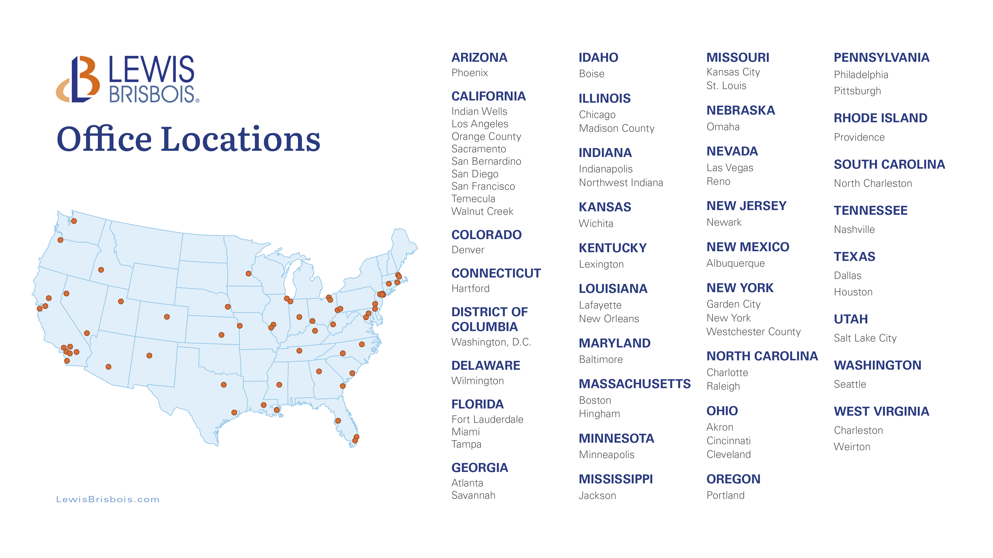

Slide 31
Francis G.X. Pileggi is the managing partner of the Wilmington office of Lewis Brisbois, Co-Chair of the Directors & Officers Litigation Practice, and a member of the Complex Business & Commercial Litigation Practice. His litigation practice emphasizes representation in high-stakes disputes of corporations, stockholders, members of boards of directors, members and managers of LLCs, and those with managerial or ownership interests in other forms of entities. He has extensive experience in matters involving fiduciary duties and corporate governance as well as summary proceedings under the Delaware General Corporation Law in the Delaware Court of Chancery.
He has been asked to testify as an expert witness on Delaware Corporate Law and Delaware LLC Law. One of his law review articles on corporate law has been cited by both the Delaware Supreme Court and the Delaware Court of Chancery. The Delaware Superior Court also cited one of his articles.
He has maintained for over 20 years the Delaware Corporate and Commercial Litigation Blog at www.DelawareLitigation.com, and he is the Editor-in-Chief of the National Law Review’s Delaware Corporate & Commercial Law Monitor.
He is also a co-host of the Delaware Corporate Litigation Insights Podcast, available on Apple Podcasts.
Francis.Pileggi@lewisbrisbois.com
302.985.6002

Slide 32
Sean Brennecke is a partner in the Wilmington office of Lewis Brisbois and is vice-chair of the Directors & Officers Litigation Practice. For more than 15 years, Mr. Brennecke has represented corporations, alternative entities, and their respective directors, officers, shareholders, members, and managers, in complex litigation matters which frequently involve expedited proceedings and injunction practice. Mr. Brennecke’s clients have ranged from two-member limited liability entities to large multi-national corporations, and from a single person to boards of directors.
Mr. Brennecke primarily practices in the Court of Chancery of the State of Delaware and the Superior Court of the State of Delaware; with a focus on the Complex Commercial Litigation Division. However, he has extensive experience litigating in the United States District Court for the District of Delaware and is often called upon to serve as Delaware or New Jersey counsel in patent infringement cases pending in Federal Courts in Delaware and New Jersey. He also has experience litigating adversary cases in the United States Bankruptcy Court for the District of Delaware and co-authored a chapter of ‘Representing the Creditors’ Committee, A Guide for Practitioners’ which was published by the American Bankruptcy Institute in 2016.
Sean.Brennecke@lewisbrisbois.com
302.985.6009

Slide 33
Chauna Abner is licensed to practice law in Maryland only. Chauna is a business and commercial litigation partner at Lewis Brisbois where she represents clients to resolve a wide range of business disputes in state and federal court and in arbitration.
Chauna’s practice focuses on high-stakes disputes of corporations and other forms of entities, stockholders, members of boards of directors, and members and managers of LLCs. She has extensive experience in matters involving demands for books and records, fiduciary duties, and corporate governance. She also has experience representing financial institutions in a myriad of consumer financial disputes.
A graduate of Dartmouth College and American University Washington College of Law, Chauna has been recognized as a top-rated business litigation attorney by Super Lawyers and as a Top 40 Under 40 attorney by the National Black Lawyers.
She is also a co-host of the Delaware Corporate Litigation Insights Podcast, available on Apple Podcasts.
Chauna.Abner@lewisbrisbois.com
410.319.2709

